Slide 1


I.T sheliyah jafri B.C.A college
Project Title
Online Mobile & Laptop Shopping
Present By:-
Patel Nishith
Momin Mahedi

Slide 2
Index
NO | SR .NO | PARTICULAR | PAGE NO.
1 |  | Introduction
 | 1.1 | Project Definition | 4
 | 1.2 | Project Profile | 5
 | 1.3 | Hardware and Software Requirement | 6
 | 1.4 | Need For system development | 7
2 |  | System Design | 13
 | 2.1 | Data Flow Diagram | 9 to 17
 | 2.2 | E-R Diagram | 19
 | 2.3 | Data dictionary | 21 to 30
 | 2.4 | Screen Short | 32 to 47

Slide 3
Introduction

Slide 4
Project Definition :-
The Project definition is “Online Mobile & Laptop Shopping”.
Introduction:-
To provide a web site that can allow a user to purchase Online Mobile & Laptop over the internet at any time.
Online shopping is one of the application to improve the marketing of the company’s product.

Slide 5
Project profile
Project Title: | Online mobile & laptop shopping
Platform: | Windows 10
Back End: | PHP MySQL
Tools: | VS Code, Sublime Text 3
Project Duration: | T.Y.BCA (sem.6)
Submitted By: | Patel nishith Momin mahediali
Submitted to: | I.T Sheliyah jafri B.C.A College

Slide 6
Hardware and Software requirement
Minimum Hardware Specification
Processor : Intel(R) Core(TM) i3-4005U
RAM : 4.00GB
Hard disk : 20GB
Minimum Software Requirements
Front end : html5, css, javascript, boostrap4, fontawesome, google font, sweet alert
Back end : PHP, Mysql

Slide 7
Need for System development
The project entitled Online Mobile & Laptop Shopping enables customer to buy mobiles and laptop from anywhere through online.
This application advertises some of the products for shopping.
To buy mobile and laptop products.
Customer not only he can view the products, he can also add the product to the cart and also he can place an order to buy those products.

Slide 8
System Design Data flow diagram

Slide 9
Context Level Diagram
Request registration/order
Requested details
Online shopping system
Admin
User
Updating
User management
Product management
Response

Slide 10
First level Diagram(User)
Accepted user detail
Request for Registration
1.0
Registration
User
Register
Registration detail
Success registration
Request for Login
2.0
Login
Response Login detail
3.0
View
Product
Request for view product detail
View product info.
Product
Give Product info
Product info
Success Purchase product
Request for Product
4.0
Purchase
Product
Product information
Product info
Give Product info

Slide 11
1.0 level Diagram(User registration)
Request for Registration info
User
1.1
Verification
Request for Registration info
Register
1.2
Creating Account
Storing User Details
Get username & password
Give username & password
1.3
Accessing Account
Request User Access Account

Slide 12
2.0 level Diagram(User login)
Request for login
(Username & password)
2.1
Login
Request for login
User
Register
Response User details

Slide 13
4.0 level Diagram(Placing order)
Order info
4.1
Purchase
product
User
Request for Order
Product
Response for Order
Response Order
View cart
4.2
Manage&
Adding product to cart
Manage order info
Cart
Add to cart product& remove product

Slide 14
First level Diagram(Admin)
Admin
Verified Login Detail
Login Detail
7.0
Login
Login
Response
8.0
View user
detail
Update and delete user
User detail
User
Response
9.0
Add & Remove category
Update Category Detail
Add/Remove category Detail
Category
Response
10.0
Add & Remove Product
Update/Remove Product Detail
Product
Add/Remove product Detail
Response
Feedback Detail
11.0
View
Feedback
Remove Feedback
feedback
Response

Slide 15
7.0 level Diagram(Admin login)
Request For
Login
7.1
Login
Request For Login Data
Admin
Register
Request For Login Data
Request For
Login

Slide 16
8.0 level Diagram(Admin)
Request for view
user detail
8.2
View User
Detail
Manage User detail
Admin
User
New user Info
Manage user
8.2
Delete
user
Request for delete user

Slide 17
11.0 level Diagram(Admin)
Request for view
feedback
11.1
View
Feedback
Request For Manage
Feedback Data
Admin
Feedback
Feedback info
Manage
Feedback info
11.2
Delete
Feedback
Request for delete Feedback

Slide 18
9.0 level Diagram(Admin Add& remove product )
Insert category
Detail
Admin
9.1
Add Category
Request for add category data
category
Response for add category data
Request for delete category
9.2
Delete
Category
Response for delete category

Slide 19
10.0 level Diagram(Admin Add& remove product )
Insert Product
Detail
Admin
10.1
Add product
Request for add Product data
Product
Response for add Product data
10.2
Update product
Request for update Product
Response for update Product
10.3
Delete product
Request for delete Product

Slide 20
System Design E-R diagram

Slide 21
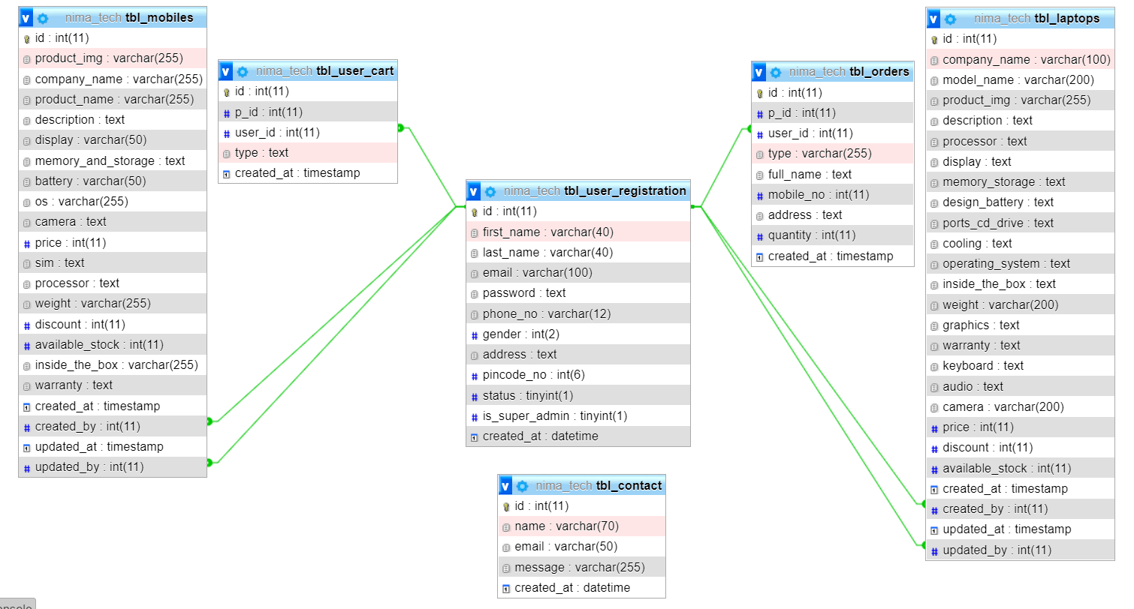

Slide 22
System Design Data dictionary

Slide 23
User registration data dictionary
Table Name:- tbl_user_registration
Column Name | Type | Size | Constraint | Description
id | Int | 11 | Not null (primary key) | Id of the customer
first_name | varchar | 40 | - | First Name of the customer
Last_name | varchar | 40 | - | Last Name of the customer
email | varchar | 100 | - | Email of the customer
password | text | - | - | Password of the customer
phone_no | varchar | 12 | - | Phone of the customer
address | varchar | - | - | Address of the customer
Pincode_no | int | 6 | - | Pin code of the customer
status | tinyint | 1 | - | status of the customer
is_super_admin | tinyint | 1 | - | Check user is super admin
created_at | datetime | - | - | current time of user account creation

Slide 24
Feedback data dictionary
Table Name:- tbl_contact
Field-Name | Data Type | Size | Constraint | Description
id | int | 11 | Not null (primary key) | id
name | varchar | 70 | - | Name Of User
email | varchar | 50 | - | Email Address of User
message | varchar | 255 | - | Feedback of User
Created_at | datetime | - | - | Current time of feedback

Slide 25
Product data dictionary
Table Name:- tbl_mobiles
FIELDNAME | DATATYPE | DESCRIPTION | CONSTRAINTS
Id | Int(11) | Id of mobile | Not null (primary key)
product_img | Varchar(255) | image of mobile | -
company_name | Varchar(255) | Company name of mobile | -
product_name | Varchar(255) | name of mobile | -
description | text | description of mobile | -
display | Varchar(50) | Display of mobile | -
memory_and_storage | Text | Memory and storage | -
battery | Varchar(50) | Battery of mobile | -
os | Varchar(255) | OS of mobile | -
camera | Text | Camera of mobile | -
price | Int(11) | Price of mobile | -
sim | Text | Sim of mobile | -
processor | Text | Processor of mobile | -
weight | Varchar(255) | Weight of mobile | -
discount | Int(11) | Discount | -
Available_stock | Int(11) | Available stock | -
Inside_the_box | Varchar(255) | Inside box | -
warranty | Text | Warranty | -
created_at | Datetime | Current time | -
created_by | Int(11) | - | -
updated_at | Datetime | - | -
updated_by | Int(11) | - | -

Slide 26
Table Name:- tbl_laptops
FIELDNAME | DATATYPE | DESCRIPTION | CONSTRAINTS
Id | Int(11) | Id of mobile | Not null (primary key)
company_name | Varchar(100) | Company name of laptop | -
model_name | Varchar(200) | name of laptop | -
product_img | Varchar(255) | image of laptop | -
Description | Text | description of laptop | -
Processor | Text | Processor of laptop
Display | Text | Display of laptop | -
memory_storage | Text | Memory and storage | -
Design_battery | Text | Battery of laptop | -
ports_cd_drive | Text | OS of laptop | -
Cooling | Text | Camera of laptop | -
Operatin_system | Text | Price of laptop | -
Inside_the_box | Text | Sim of laptop | -
Weight | Varchar(200) | Processor of laptop | -
Graphics | Text | Weight of laptop | -
Warranty | Varchar(200) | Discount of laptop | -
Keyboard | Text | Keyboard of laptop
Audio | Text | Audio of laptop
Camera | Varchar(200) | Camera of laptop
Price | Int(11) | Price of laptop
Discount | Int(11) | Discount of laptop
Available_stock | Int(11) | Available stock | -
created_at | Datetime | Current time | -
created_by | Int(11) | - | -
updated_at | Datetime | - | -
updated_by | Int(11) | - | -

Slide 27
Cart data dictionary
Table Name:- tbl_user_cart
FIELDNAME | DATATYPE | DESCRIPTION | CONSTRAINTS
id | Int(11) | id | Not null (primary key)
P_id | Int(11) | product id | -
User_id | Int(11) | User id | -
Type | Text | Product type | -
Created_at | Datetime | Current time of add to cart product | -

Slide 28
order data dictionary
Table Name:- tbl_orders
FIELDNAME | DATATYPE | DESCRIPTION | CONSTRAINTS
id | Int(11) | id | Not null (primary key)
P_id | Int(11) | product id | -
User_id | Int(11) | User id | -
Type | Varchar(255) | Product type | -
Full_name | Text | Full name of user
Mobile_no | Int(11) | Mobile number of user | -
Address | Text | Address of user | -
quantity | Int(11) | Quantity of product | -
Created_at | Datetime | Current time of add to cart product | -

Slide 29
System Design Screen Layout

Slide 30

Home page

Slide 31
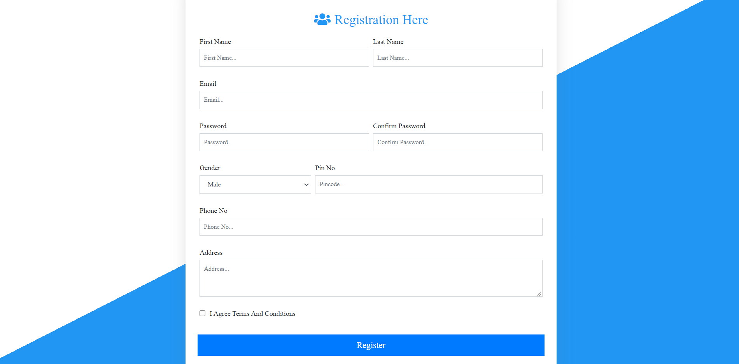
Registration

Slide 32
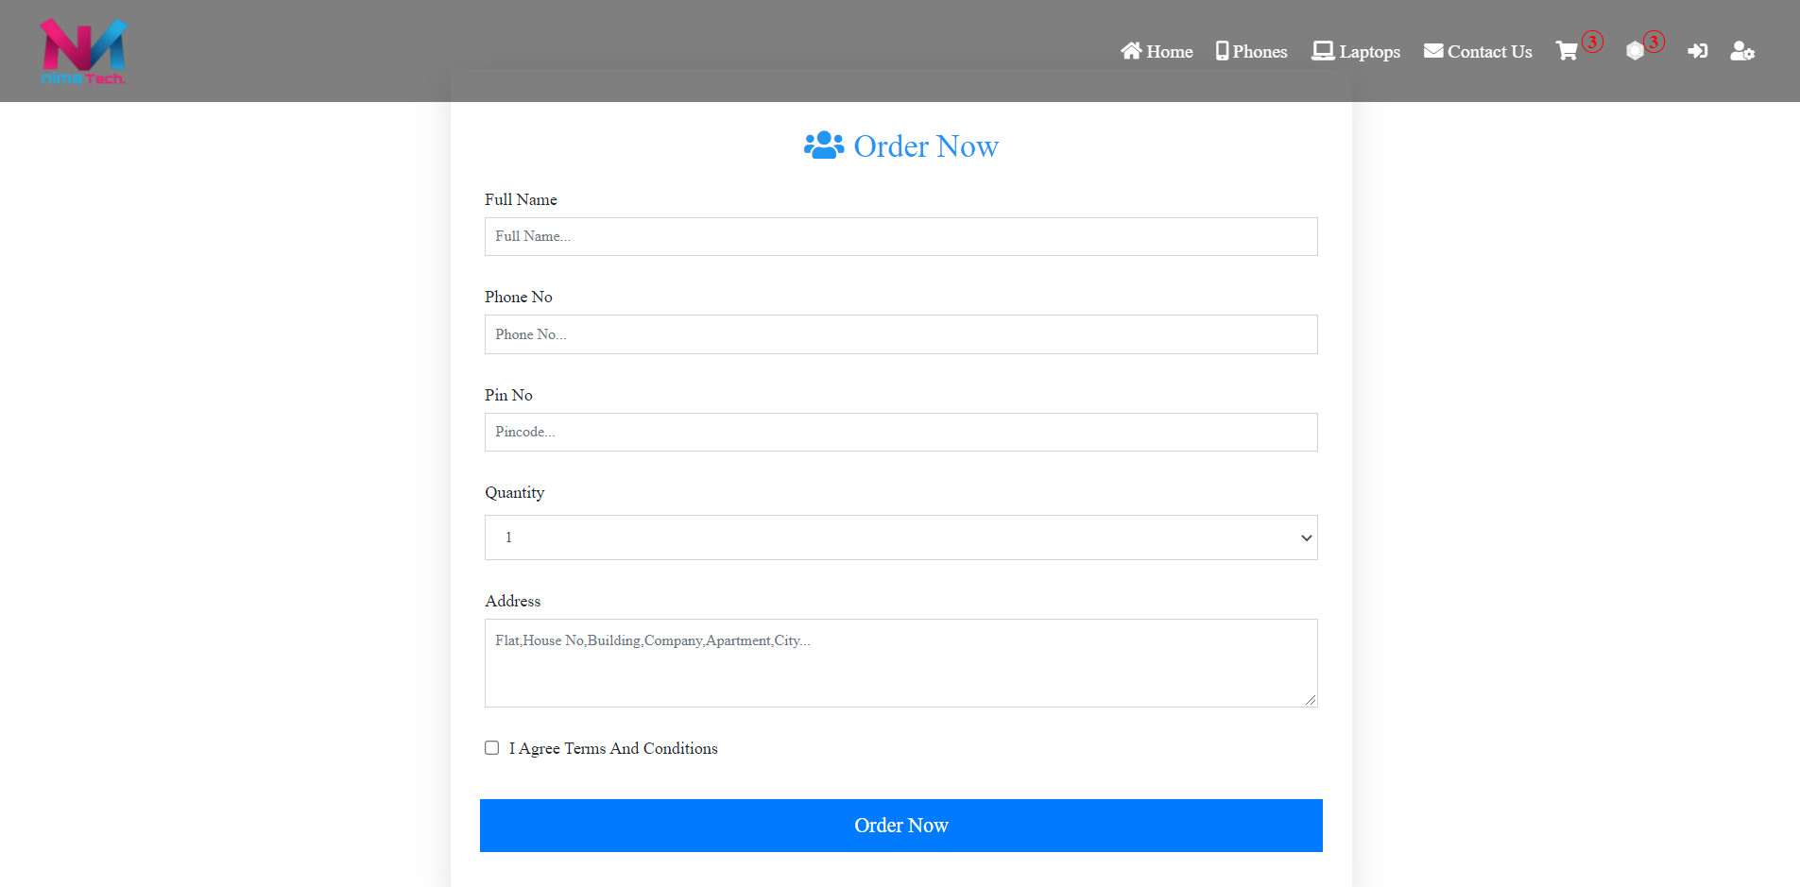
Order Page

Slide 33
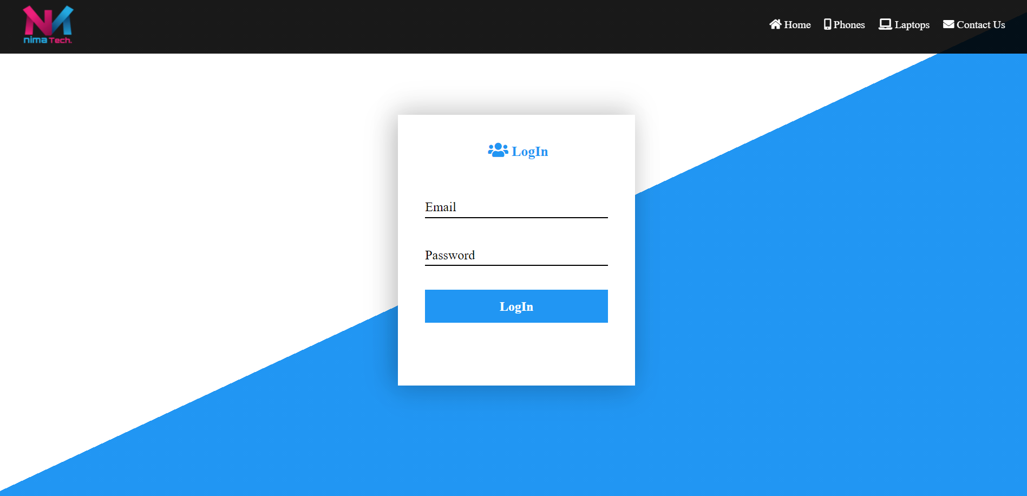
Login

Slide 34
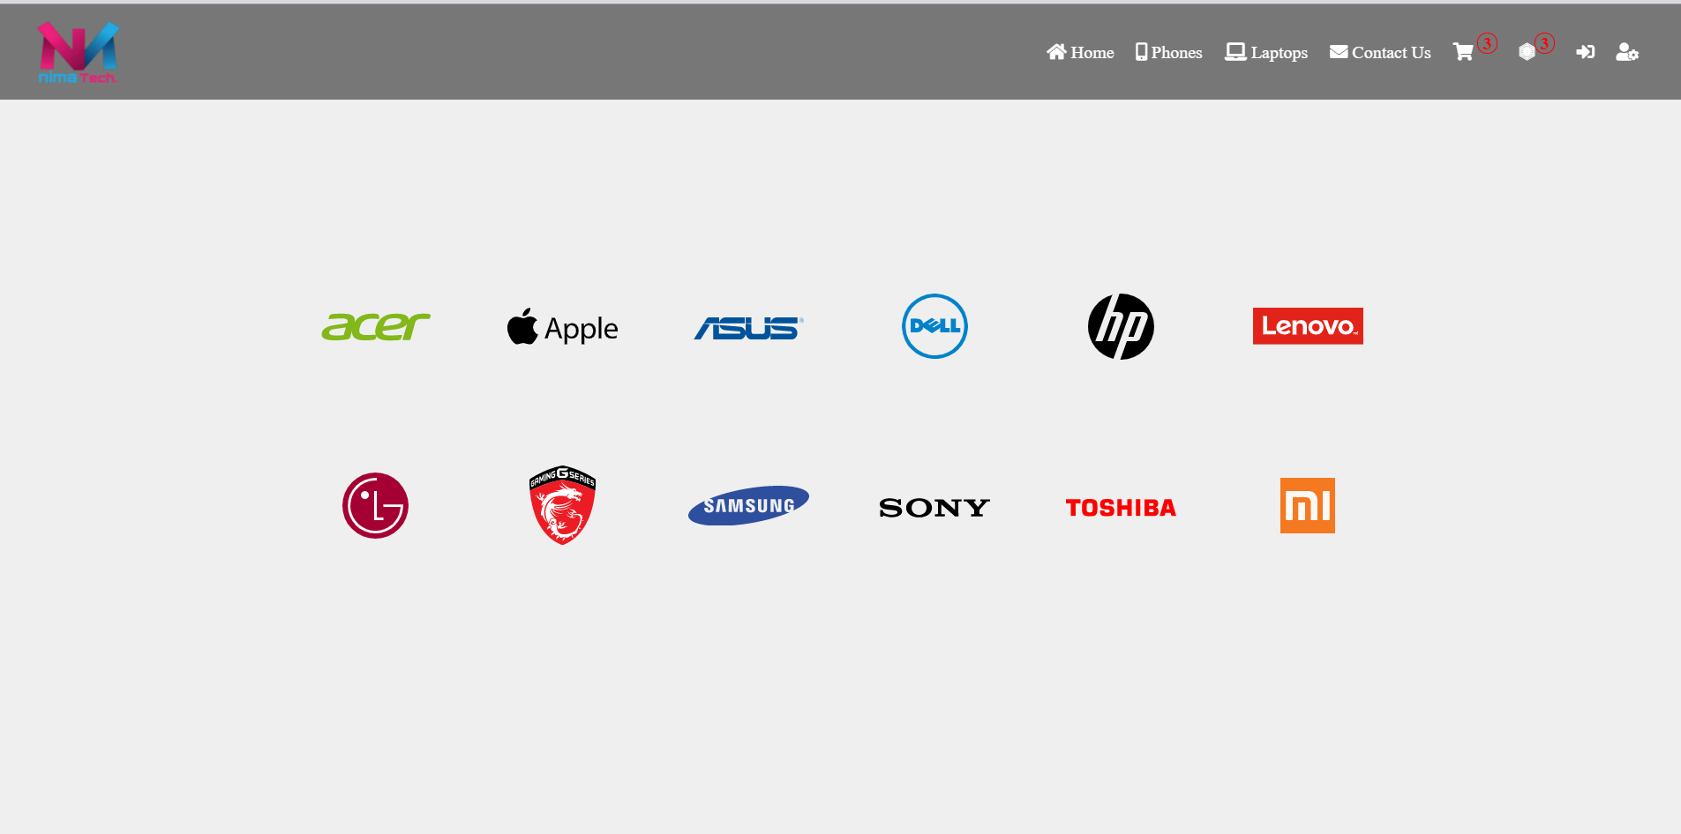
Listing Page

Slide 35
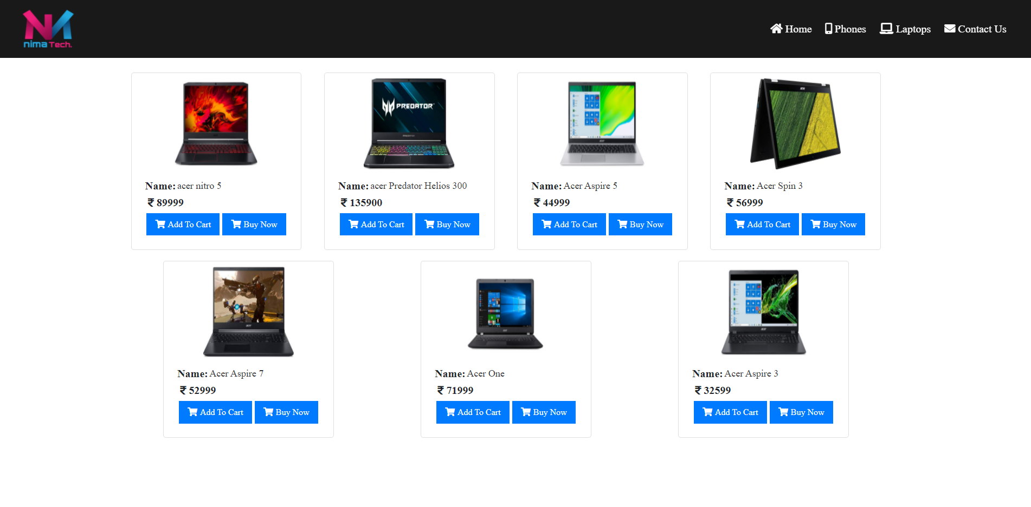
Product View

Slide 36
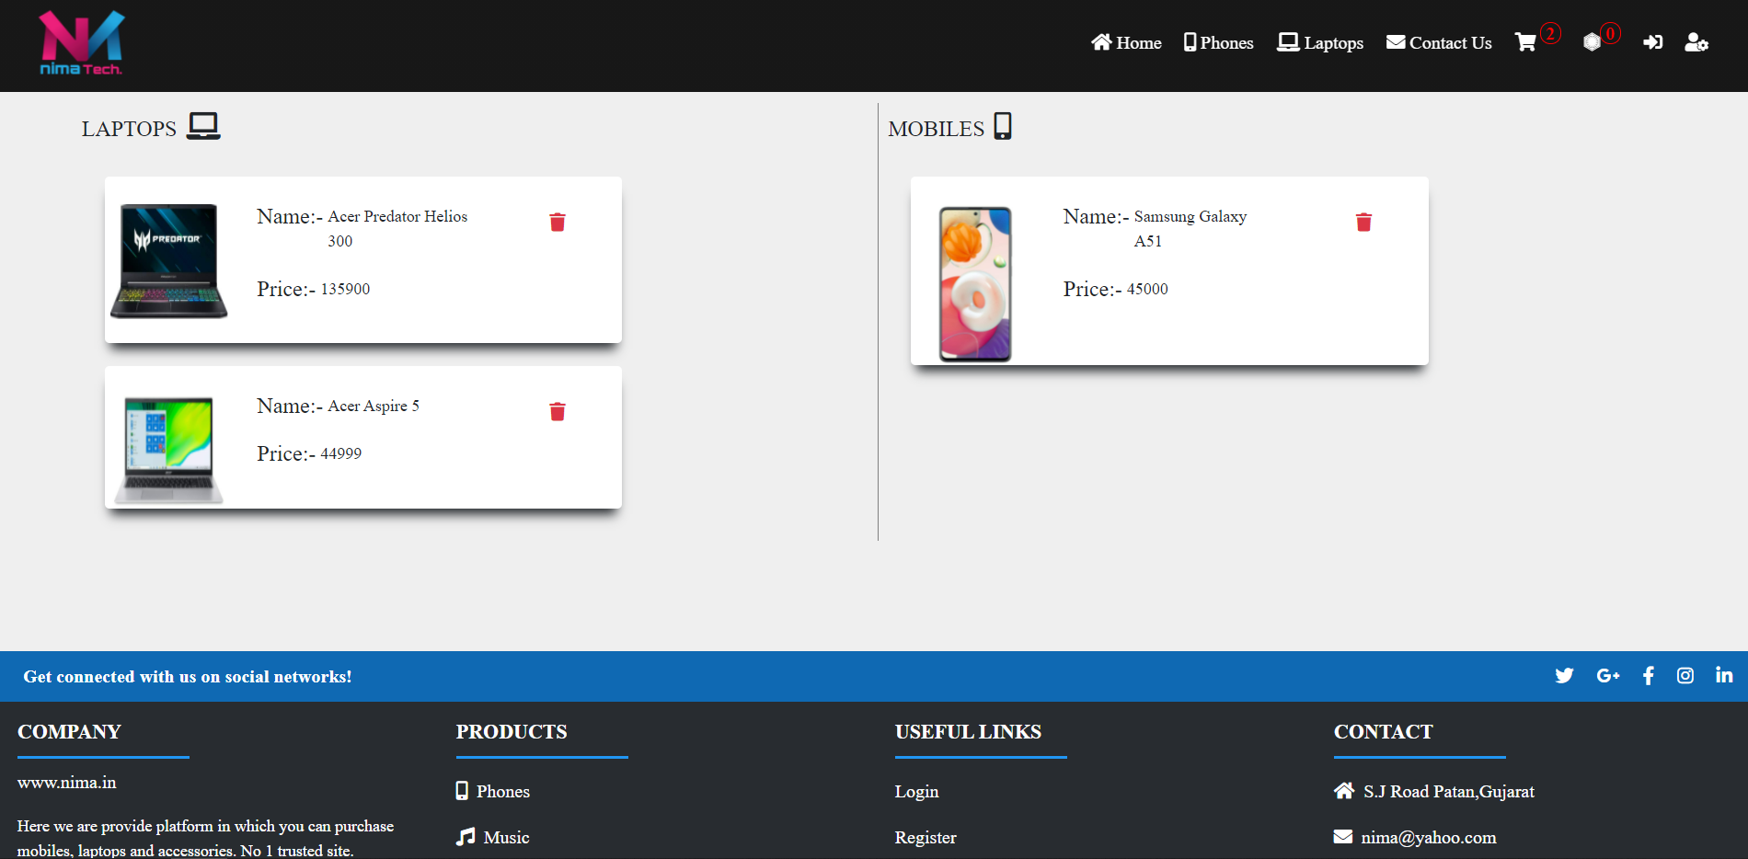
My cart

Slide 37
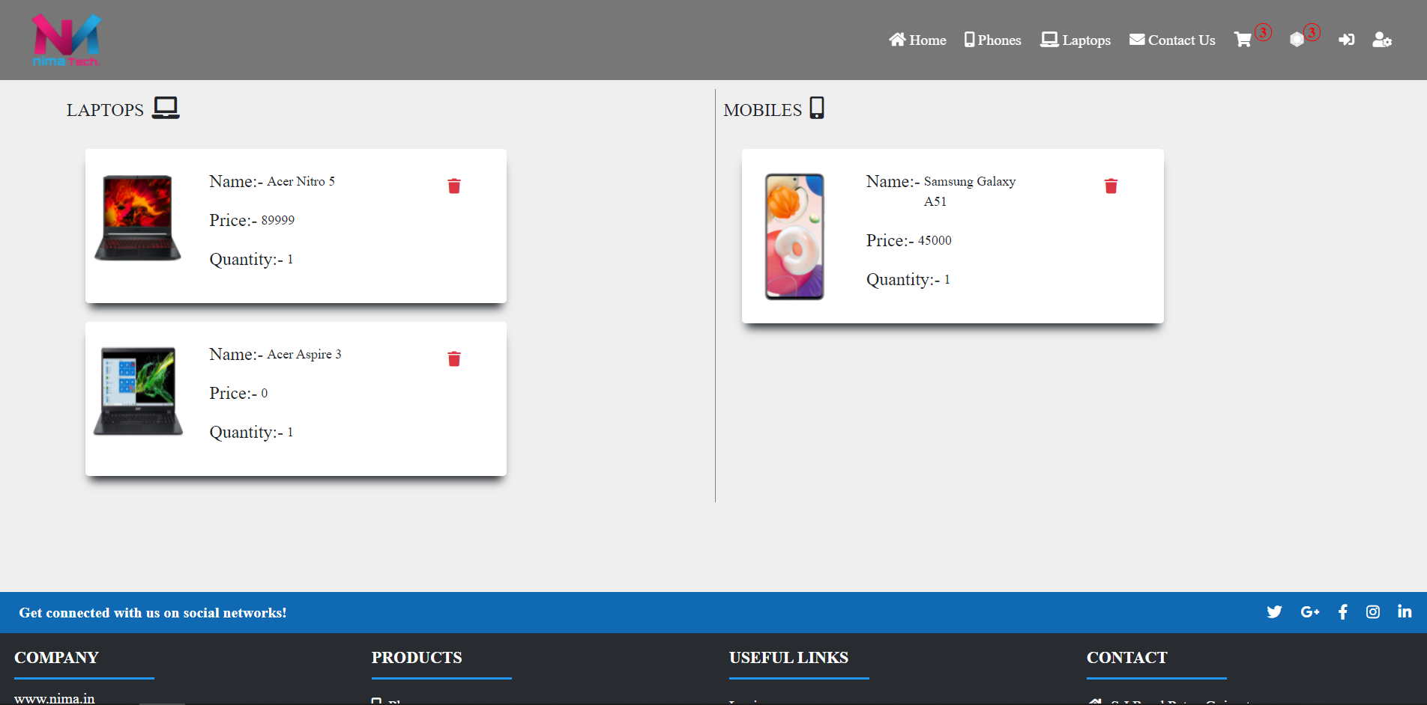
Order Show Page

Slide 38
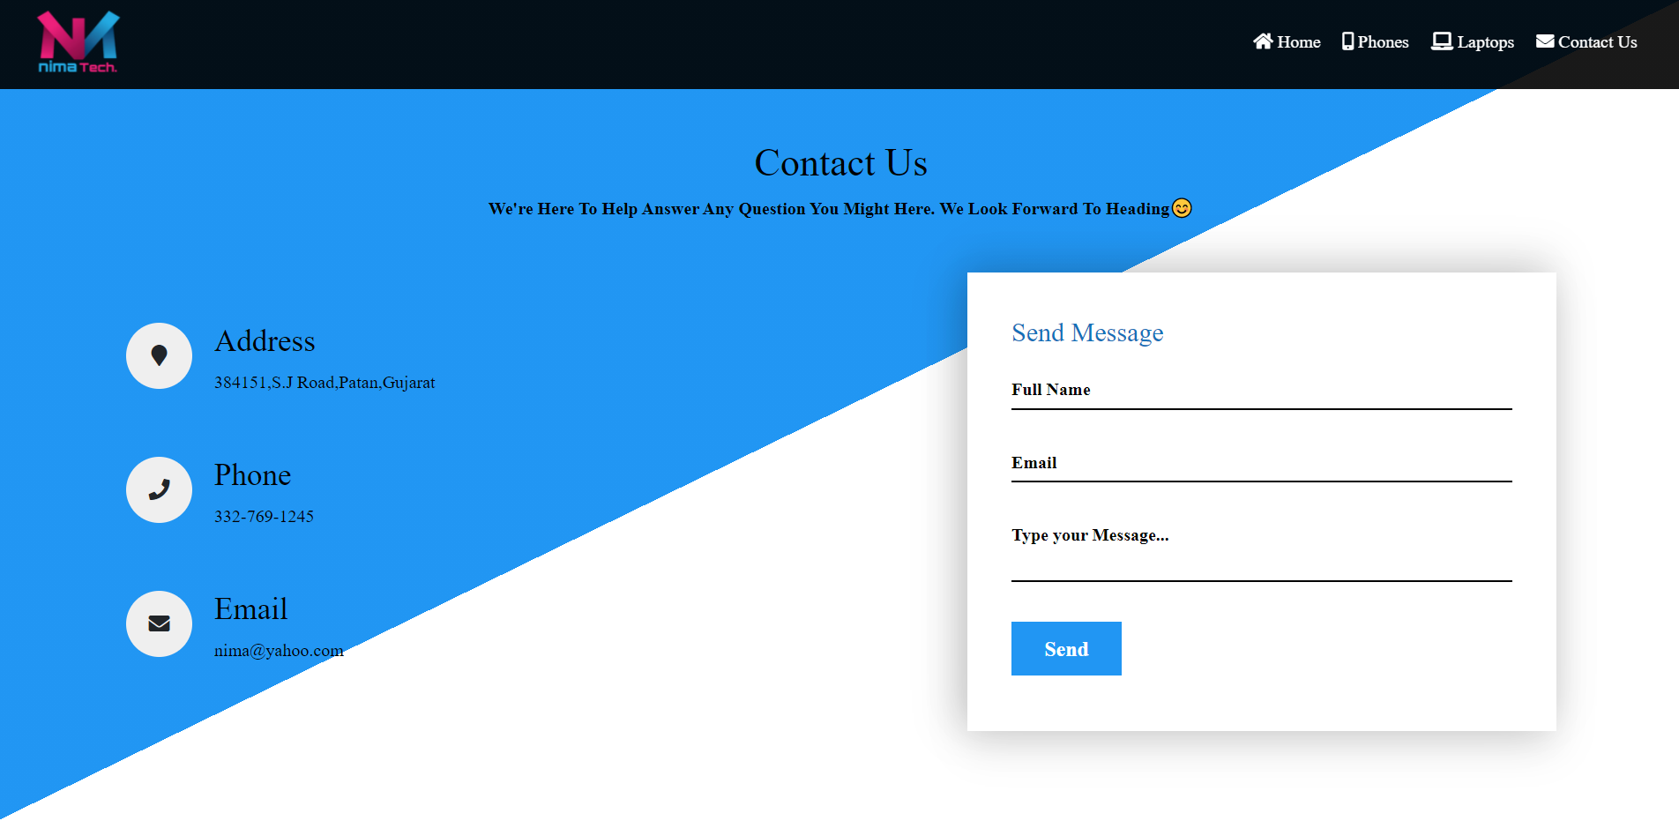
Feedback

Slide 39
System Design Admin Screen Layout

Slide 40
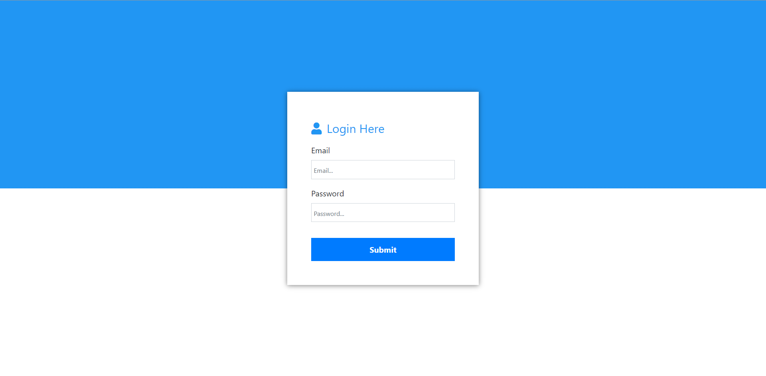
Admin login

Slide 41
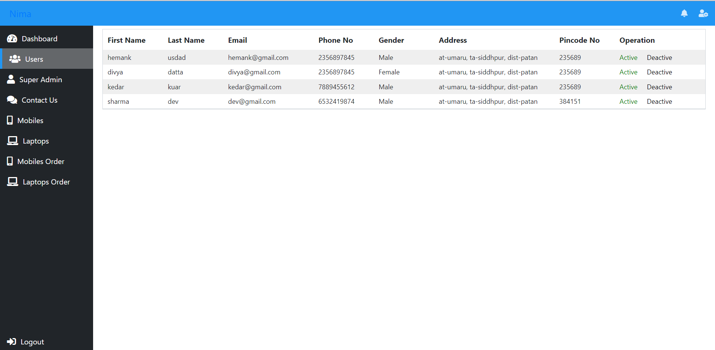
Manage User

Slide 42
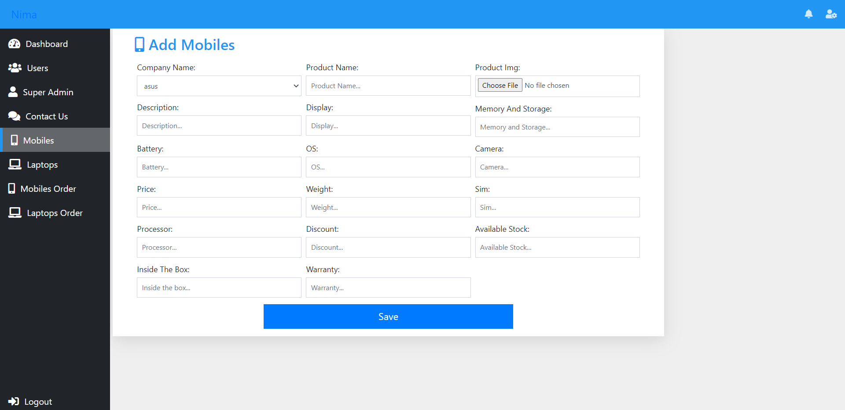
Add product

Slide 43
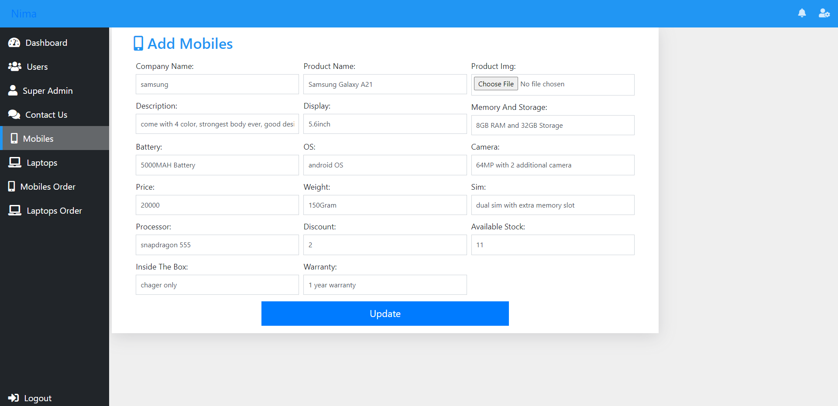
Manage Product

Slide 44
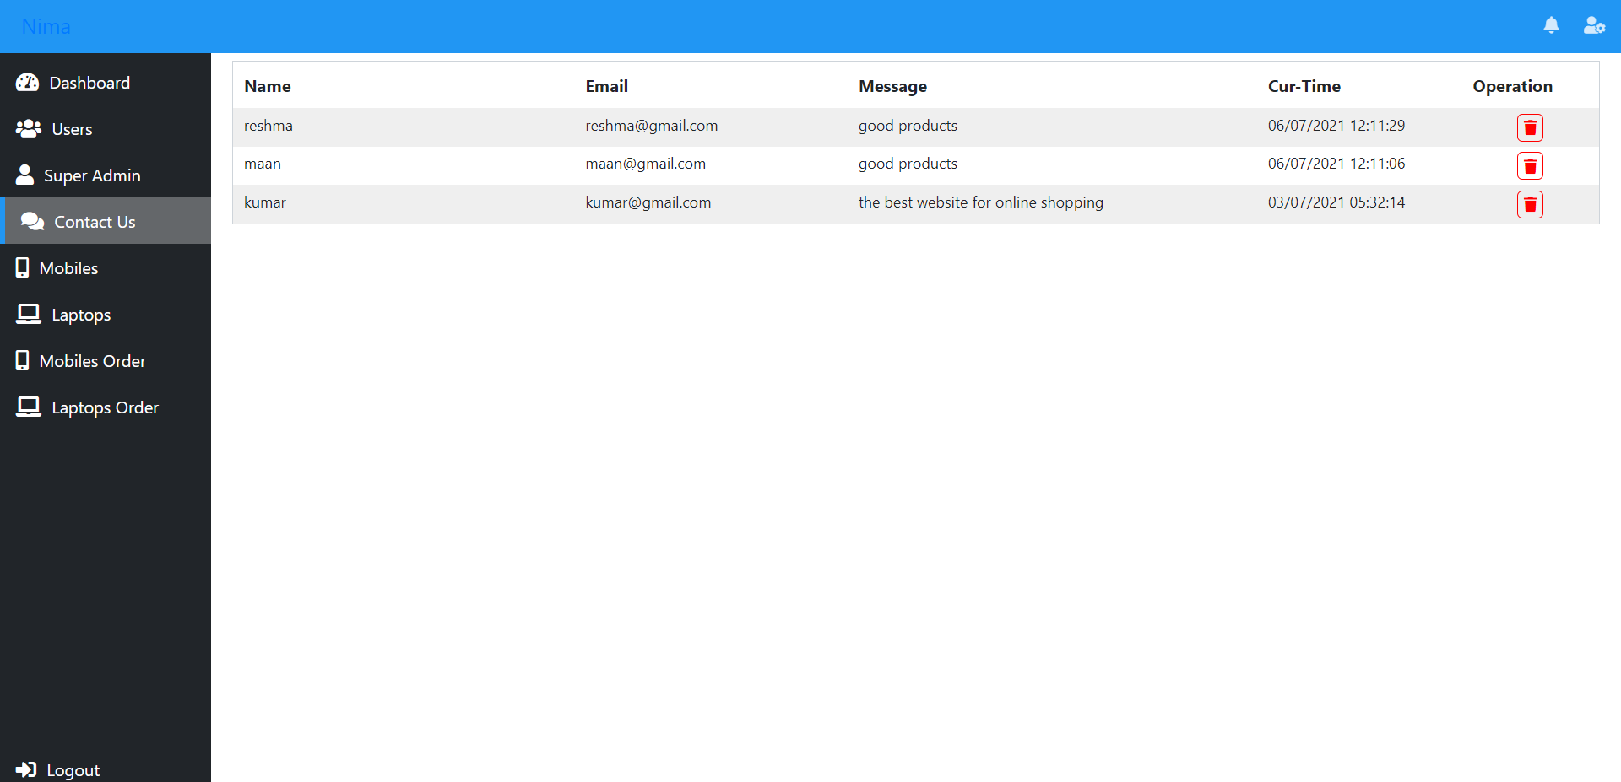
Manage Feedback

Slide 45


